Slide 1
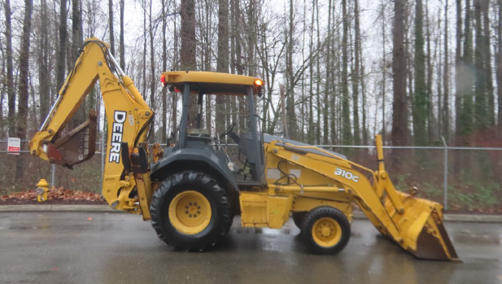
RFP Pricing Tabulation
Respondent | Octane Forklifts, Inc.
Location | Denver, Colorado
Item Description | Quantity | Unit Price
CASE 580K | 1 | No Bid
DEERE 310G | 1 | $48,059
CAT 420F | 1 | No Bid
Delivery Fee | 1 | Included
Total | $48,059
2006 Model
Used Equipment

