Slide 1
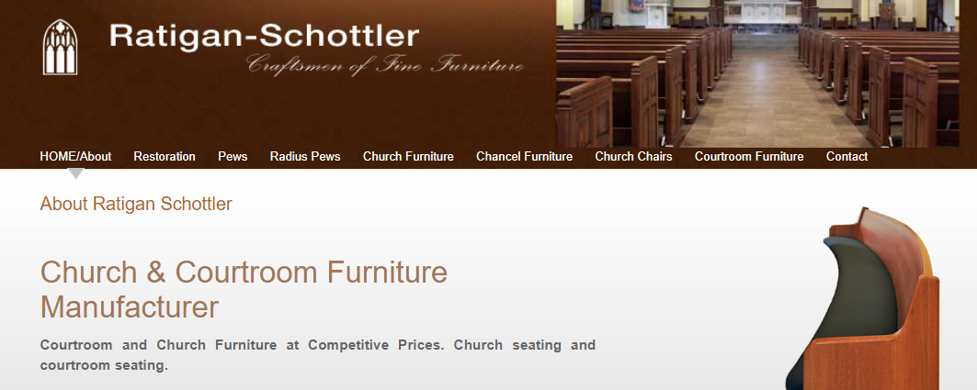
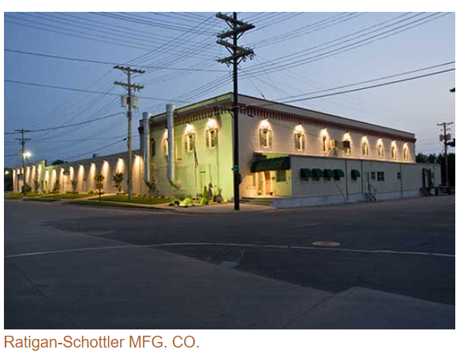
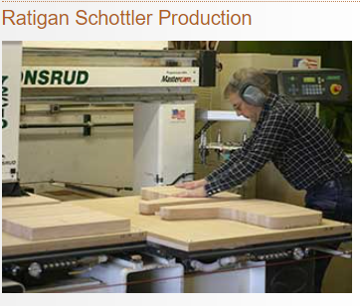
RFP Pricing Tabulation
Respondent | Ratigan Schottler Manufacturing
Location | Beatrice, Nebraska
Item Description | Quantity | Unit Price | Extended Price
Gallery Benches | 12 | $907 | $10,888
Jury Chairs | 14 | $1,350 | $18,900
Attorney Chairs | 12 | $1,350 | $16,200
Delivery and Installation | 1 | $12,683 | $12,683
Total | $58,671

