Slide 1
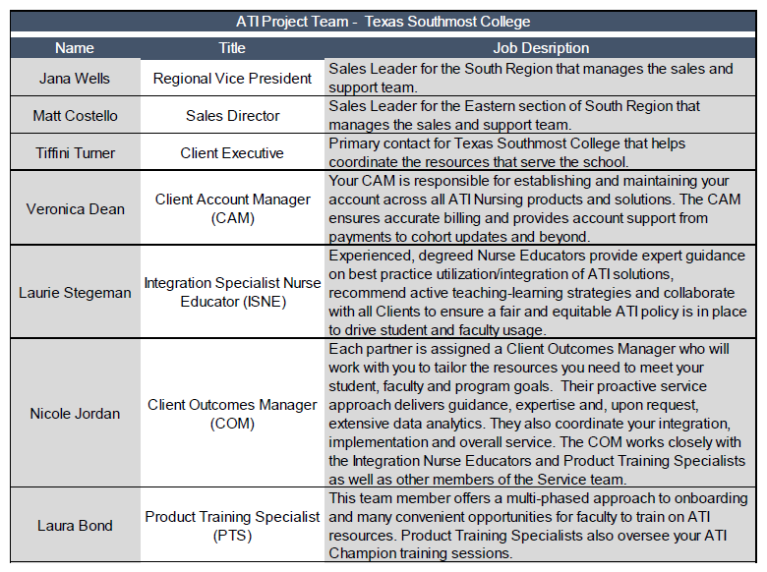
RFP Pricing Tabulation
Respondent | Location | Cost
Assessment Technologies Institute, LLC | Leawood, KS | $142,546

