Slide 1
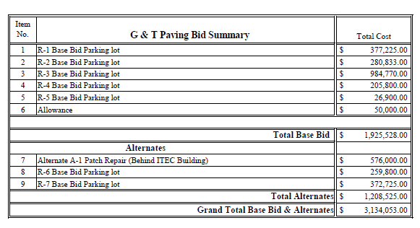
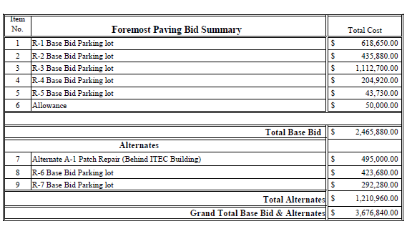
RFP Pricing and Scoring Tabulation
Location | Brownsville, Texas | Elsa, Texas
Score | 89.3 | 68.3

