Slide 1
General Orientation
Welcome from Infection Control and Employee Health

Slide 2
Host Factors
Defenses
  Intact skin
  Mucous membranes
  Immune system
  Good health
  Immunization
Susceptibility factors
  Age
  Heredity
  Nutritional status
  Stress
  Underlying disease
  lifestyle

Slide 3
Signs and Symptoms of Infection
Pain
Tenderness
Redness
Drainage
Diarrhea
Fever
Changes in vital signs
Fatigue
Appetite loss
Nausea
Vomiting

Slide 4

Infectious Agent
Susceptible Host
Mode of Transmission

Slide 5
Modes of Transmission
Direct contact
  Touching, bathing, contact with secretions
Indirect contact
  Clothing, linen, specimen containers, equipment, dressings
Droplet
  Sneezing, coughing, talking
Airborne
  Moisture or dust particles that are inhaled
Vehicle
  Water, food, blood
Vector
  Insects, animals
Not a consideration for clinical infection prevention in a healthcare setting

Slide 6
Standard Precautions
Hand hygiene
Use of barriers
Sharps safety
Respiratory etiquette
Safe injection practices

Slide 7
WHO Hand Hygiene Guidelines
Why?
  Healthcare acquired infections account for 99,000 deaths per year in the USA
  Hands are the main transmission vehicle
  Hand hygiene is, therefore THE most important measure to prevent infections

Slide 8
WHO Hand Hygiene Guidelines
Who?
  Any health care worker, caregiver, or person involved in direct or indirect patient care
  That’s all of us!

Slide 9

WHO Hand Hygiene Guidelines
How?
  Alcohol hand rubs are the preferred means for routine hand antisepsis
  Use when hands are not visibly soiled
    Faster
    More effective
    Better tolerated

Slide 10
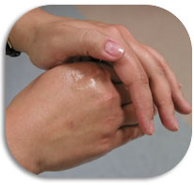
How to Handrub
Palm to palm
Palm to top of hand, interlaced fingers
Palm to palm with fingers interlaced
Back of fingers to opposing palms with fingers interlaced
Clasped fingers to palm
Rotational rubbing of thumbs
Total Time: 20-30 seconds
-on the fly!

Slide 11
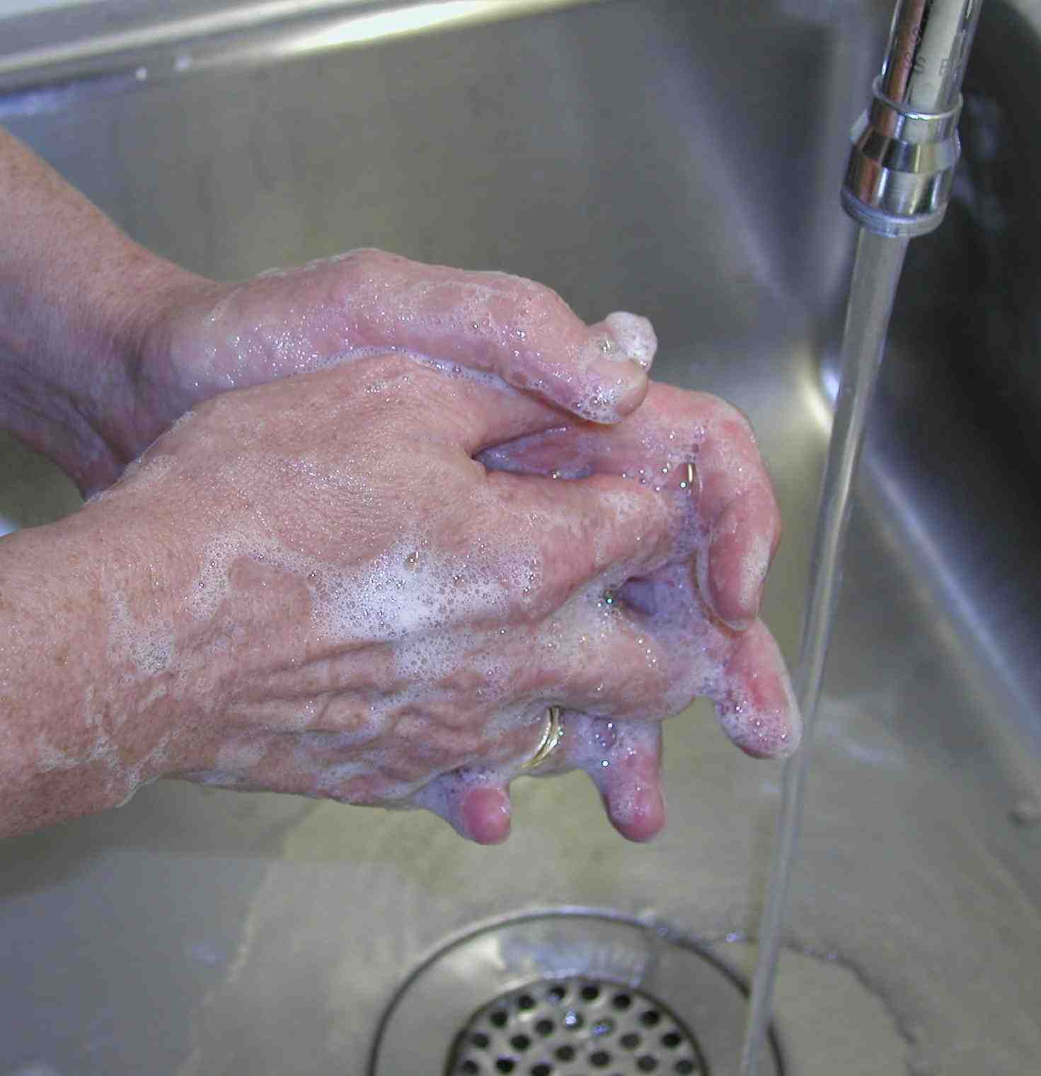
Handwashing
When hands are visibly soiled
After contact with blood or body fluids
After using the toilet
Otherwise, USE HANDRUB

Slide 12
Handwashing
Turn on tap, adjust water temperature
Wet hands then apply soap
Perform same maneuvers as for hand rubbing
Rinse with water
Dry hands with paper towel
Use paper towel to turn off faucet
Total Time: 40-60 seconds
at the sink

Slide 14

Hand Hygiene Surveillance
You can’t manage what you don’t measure
Managers held accountable for the rates and trends in their units
Individuals held accountable by managers

Slide 15

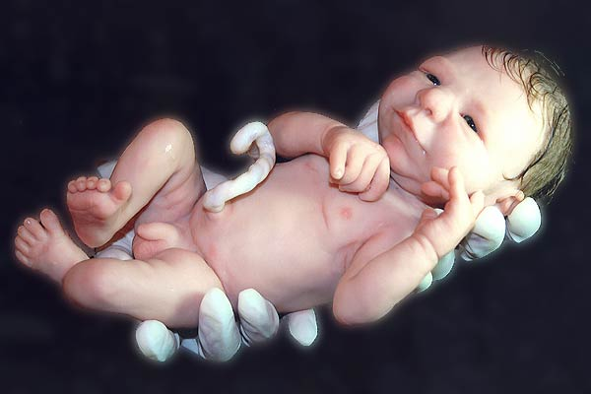
Barrier Precautions
Because you never know!

Slide 16
If it’s wet, wear gloves!
Gloves act as a barrier between you and the patient’s blood or body fluids
Hand hygiene before and after using gloves
  Gloves provide a warm moist environment where the germs on your hands can multiply
  52-63% of gloves leak
  Bacteria on your hands can be transferred to surfaces and other people for 3 hours after your gloves are removed if you don’t decontaminate your hands!
  Gloves are single use only

Slide 17
Removing Gloves
To remove a glove, grasp it just below the cuff
Pull the glove down over the hand so that it is turned inside out
While removing the first glove, do not allow the soiled, outside portion to touch skin
Hold the removed glove with other gloved hand
Reach inside the other glove at the wrist with the first two fingers of the ungloved hand
Pull the glove down over the hand and the other glove
Discard both gloves in appropriate container
Perform hand hygiene

Slide 18
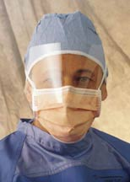
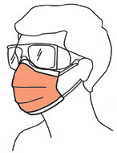
Use fluid shield mask with visor or goggles if splashing likely

Slide 19
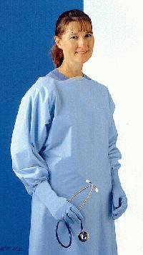
Wear a waterproof gown if you are likely to get your clothes soiled or wet

Slide 20

Wear shoe covers if you anticipate encountering large amounts of blood (OR, L&D)

Slide 21
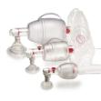

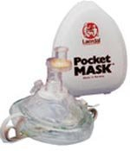
Use face shields, pocket masks or ambu bags to deliver ventilations

Slide 22

Proper order of PPE
Donning and Doffing
Donning (ON)
Perform hand hygiene
Gown
Mask or Respirator
Goggles, eye protection
Gloves
Doffing (OFF)
Gloves
Goggles, eye protection
Gown
Mask or Respirator
Perform Hand Hygiene
Except for respirator (N-95), remove PPE at doorway or in anteroom.
Remove respirator after leaving patient room and closing the door.

Slide 23

Safe Injection Practices

Slide 24

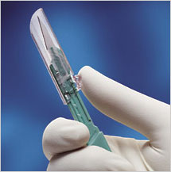
Handle sharps as if your life depends on it (it does!)
Deploy the safety mechanism!
Do not recap, shear or break needles
Be aware that trash or linen may contain
sharps that were not disposed of properly

Slide 25
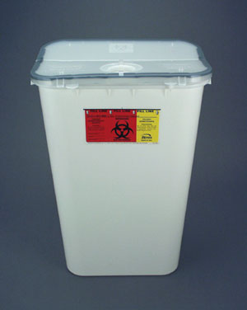

Dispose of sharps as if your coworker’s life depends on it
Report any sharps containers that are mounted
too high or are not easily accessible
Change sharps containers when ¾ full
Dispose of sharps immediately after use
Remember our housekeepers and laundry handlers!!

Slide 26

Practice Good Housekeeping
Clean all equipment and surfaces as soon as possible after contact with potentially infectious materials
2 minutes kills bloodborne pathogens
5 minutes (wet) for other germs

Slide 27
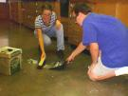
Practice Good Housekeeping
Do not pick up broken glass with gloved or bare hands
Use tongs, forceps or a brush and dustpan

Slide 28
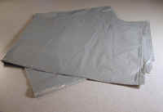
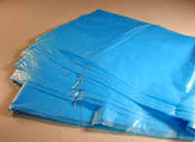

Handle trash and linen as little as possible
Do not sort or rinse linen before
bagging
Carry trash and linen away
from your body
When emptying trash, shake
down instead of pushing down
Change bags when 2/3 full
Household Trash
Linen
Biohazardous Waste

Slide 29
What Goes Into Red Bags?
Liquid Blood and Body Fluids (more than 30 mls)
Blood bags and Blood Tubing
Saturated, drippy dressings
Pathology specimens, human tissue
Microbiology Waste, Cultures

Slide 30
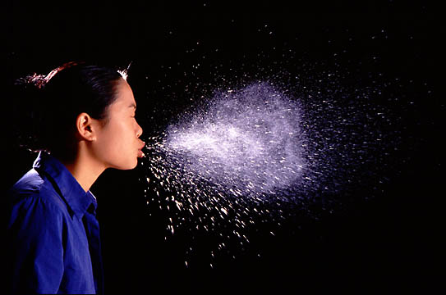
Cough Etiquette
To prevent spread of colds, flu, SARS and other droplet and airborne infections
Provide materials
  Tissues
  Mask
  Alcohol gel
Provide instructions
  Wear mask if within 6 feet of others
  Tissue use, disposal
  Hand hygiene

Slide 31
Precautions for Spinal Procedures
8 cases of meningitis were linked to oral flora of personnel performing procedures (LP’s, epidurals, spinals, etc)
Providers in those cases were not masked.

Slide 32
Transmission Based Isolation Protocols
Special protocols for infections other than blood borne.
Precautions are to be taken as soon as a disease is suspected
Use Isolation Precautions Reference from the IC Manual

Slide 33
Patient Safety and Isolation
Talk to the patient while you are in the room providing care.
Make sure the necessary equipment for isolation is available.
Provide the patient with newspapers, books, and magazines, if appropriate.
Instruct the family and visitors about the isolation techniques.
Frequently check on the patient
Place the call bell within the patient’s reach.

Slide 34

Contact Precautions
Any time the environment is likely to be contaminated
Any time you can’t contain drainage/secretions
  Wounds that you can’t keep covered or that saturate through the dressing
  Diarrhea in a patient that is incontinent or unable to practice good hygiene
When you are dealing with Multi Drug-Resistant Organisms
Methicillin resistant Staphylococcus aureus (MRSA)
Vancomycin resistant Enterococcus (VRE)
C. difficile
or other anti-biotic resistant organism (ESBL’s, CREs, etc.)

Slide 35
Contact Precautions

Slide 36
Contact Precautions PPE
Gown and gloves to enter room
  Every encounter
  Every time
Mask if the organism is in the sputum and the patient has respiratory symptoms

Slide 37
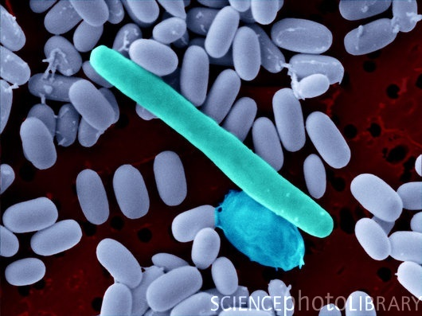
C. difficile
Resistant to disinfectants
C. difficile Associated Disease can be severe
  diarrhea, colitis, toxic megacolon and death
This germ can go dormant as a spore
    Alcohol rub, when used with gloves is sufficient hand hygiene for isolated cases
    If there is an outbreak
    Soap and water washing would be required to remove the germs (alcohol doesn’t kill the spores)
    Environmental surfaces would be cleaned with bleach

Slide 38

Droplet Precautions
Used for diseased that are spread through droplets when the patient coughs or sneezes
Don the mask to enter the room
Safety zone is 6 feet away from the patient
Common illnesses where we use contact precautions include:
  Pneumonia
  Influenza

Slide 39

Airborne Precautions
For illnesses transmitted by droplet nucleii
Expelled when pt coughs or sneezes
When droplets dry, nucleii waft into the air
Can be breathed down to the base of your lungs
Examples of diseases: Tuberculosis, measles, chicken pox
N95 Respirator required
Negative pressure room
Required
If pt leaves room, surgical
mask required

Slide 40
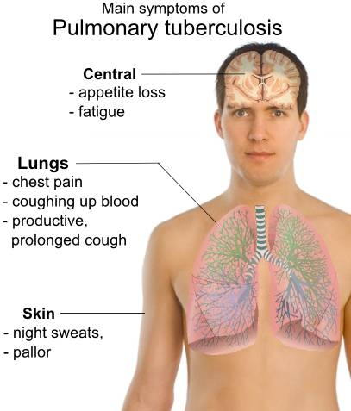

Slide 41
Questions?
Office hours are from 8:30-5:00 Monday through Friday
Located on the 1st floor off the Women’s Center Lobby
Ext 1843

